Slide 1

A PROJECT REPORT ON BRIDGE RECTIFIER CIRCUIT Subject : Fundamentals of Electricals and Electronics

Slide 2
NEOTECH INSTITUTE OF TECHNOLOGY
BACHELOR OF DIPLOMA
ENGINEERING IN
1 SEMESTER COMPUTER ENGINEERING
SUBMITTED BY
VEER PATEL
KARAN PATEL
AAYUSH SANKHAL
DEPARTMENT OF 1 SEMESTER COMPUTER ENGINEERING
NEOTECH INSTITUTE OF TECHNOLOGY ,VADODARA
AFFILATED TO GUJARAT TECHNOLOGICAL UNIVERSITY

Slide 3
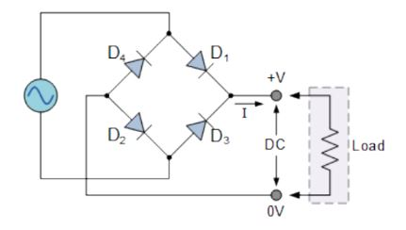
Bridge rectifier circuit

Slide 4
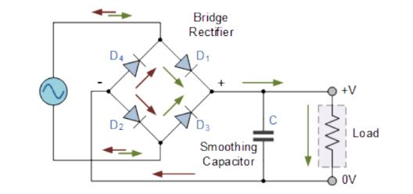
Bridge rectifier
A Bridge rectifier is similar to a full-wave rectifier because it produce a full-wave output voltage.
It convert Alternating current (AC) to Direct current (DC).
The process of converting alternating current (AC) to direct current (DC) is know as Rectification.
The electrical device which is use is know as Rectifier.
A diode bridge is an arrangement of four or more diodes in a bridge.
It use four individual rectifying diodes connected in closed loop “Bridge” configuration to produce the desire output.

Slide 5
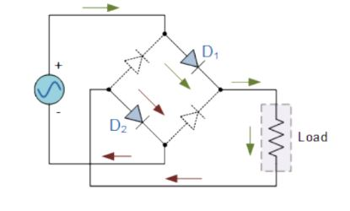
Positive half - cycle
During the positive half-cycle of the supply ,diodes D1 and D2 conduct an series while diodes D3 and D4 are reverse biased and the current flow through the load.
This produce a positive load voltage as indicated by the plus-minus polarity.

Slide 6
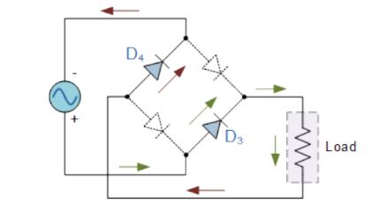
Negative half - cycle
During negative half-cycle of the supply , diodes D3 and D4 conduct in the series , but diodes D1 and D3 switch “OFF” as they are now reverse biased.
The current flowing through the load is the same direction as before.

Slide 7
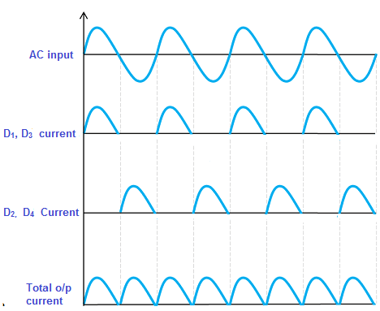
Wave formation

Slide 8
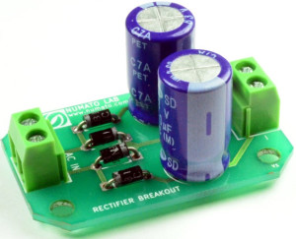
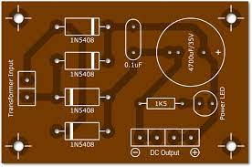
Bridge Rectifier on circuit board
Bridge Rectifier on circuit board
Bridge Rectifier circuit board

Slide 9
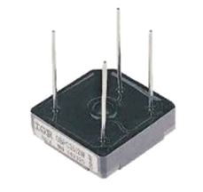
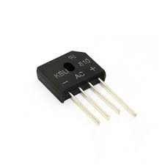
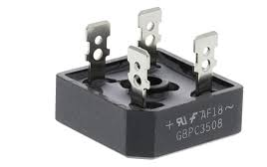
Bridge Rectifier Packages
GBPC-W
KBPM
GBPC

Slide 10
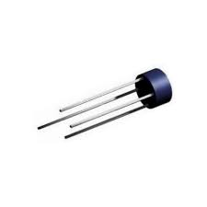
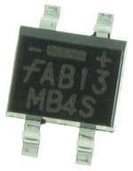
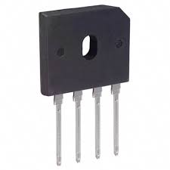
Bridge Rectifier Packages
GBU
SONIC-4
WOB

Slide 11
Parts of Bridge Rectifier
The bridge rectifier circuit diagram consists of various stages of devices like a transformer, Diode Bridge, filtering, and regulators.
Generally, all these blocks combination is called a regulated DC power supply that powers various electronic appliances.

Slide 12
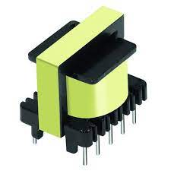
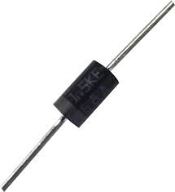
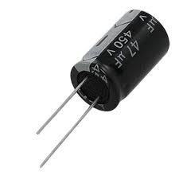
Parts of Bridge Rectifier
Transformer
Diode
Capacitor

Slide 13
Advantages and Disadvantages

